Slide 1
Uncertainty Quantification of Agent-based Models with Application to Malaria Intervention Modeling
PhD Update
July 2025

Slide 2
Individual and community protection
At what coverage level does each malaria intervention (LLINs, IRS, SMC, malaria vaccine) begin to provide community-level protection (eg., reduced malaria prevalence among non-recipients), and how do these thresholds vary across transmission settings in Ghana?
Direct protection causes a roughly linear increase early on.
Community protection (indirect effects) shows up as nonlinear acceleration.
The threshold where slope starts increasing more rapidly is a good proxy for community-level protection starting to matter.

Slide 3
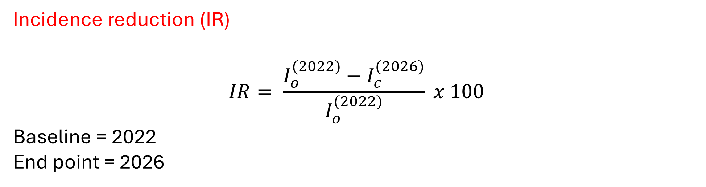
Individual and community protection
Incidence reduction (IR)
$$IR= \frac{I_{o}^{(2022)}−I_{c}^{(2026)}}{I_{o}^{(2022)}} x 100$$
Baseline = 2022
End point = 2026

Slide 4
Steps taken
Using existing simulation output
Fix all other inputs (LLIN, IRS, Vaccine) at their policy-relevant / aspirational values.
Vary SMC coverage from 0.2 to 1.0 (to match GP training range).
Predict the impact (incidence reduction) using the GP
Notes:
Isolate the impact of each intervention by fixing the coverages of the others

Slide 5
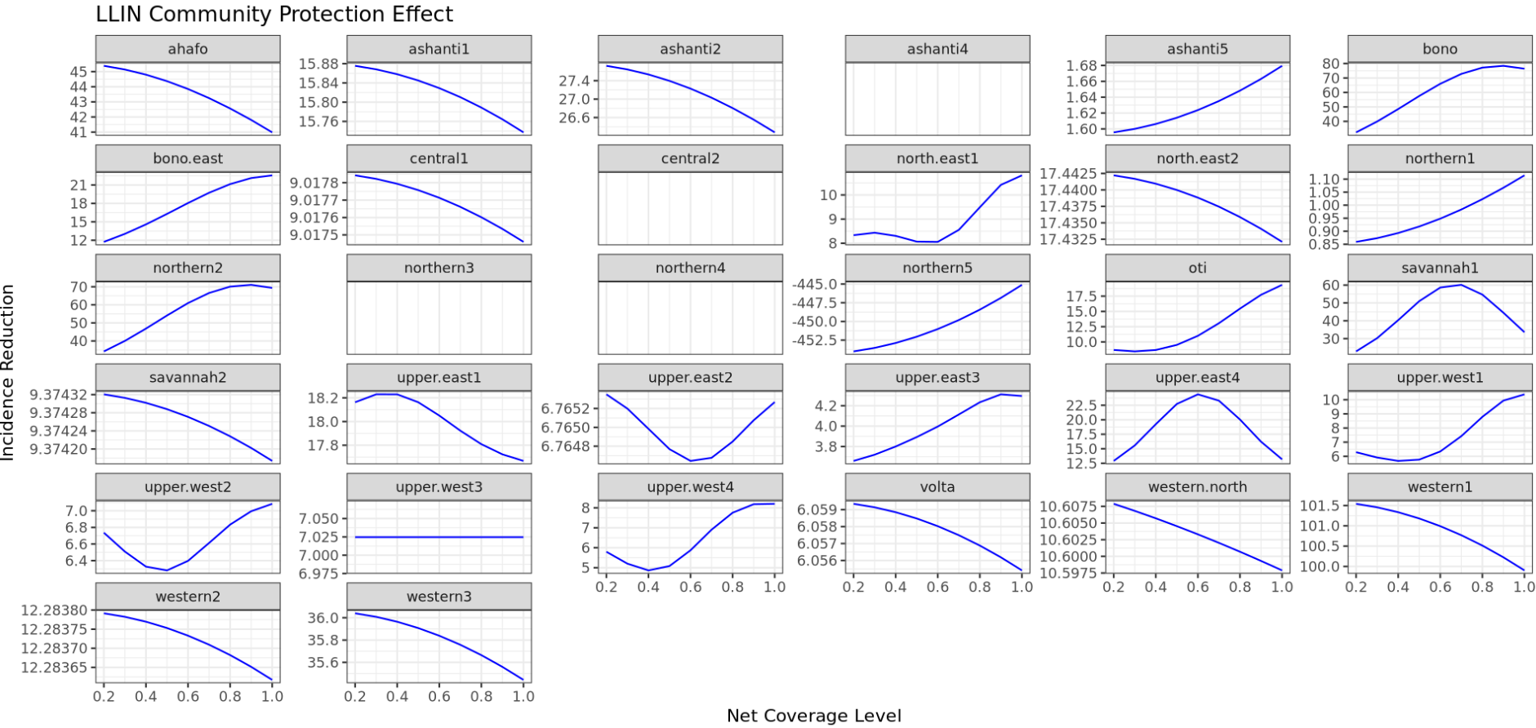
LLIN

Slide 6
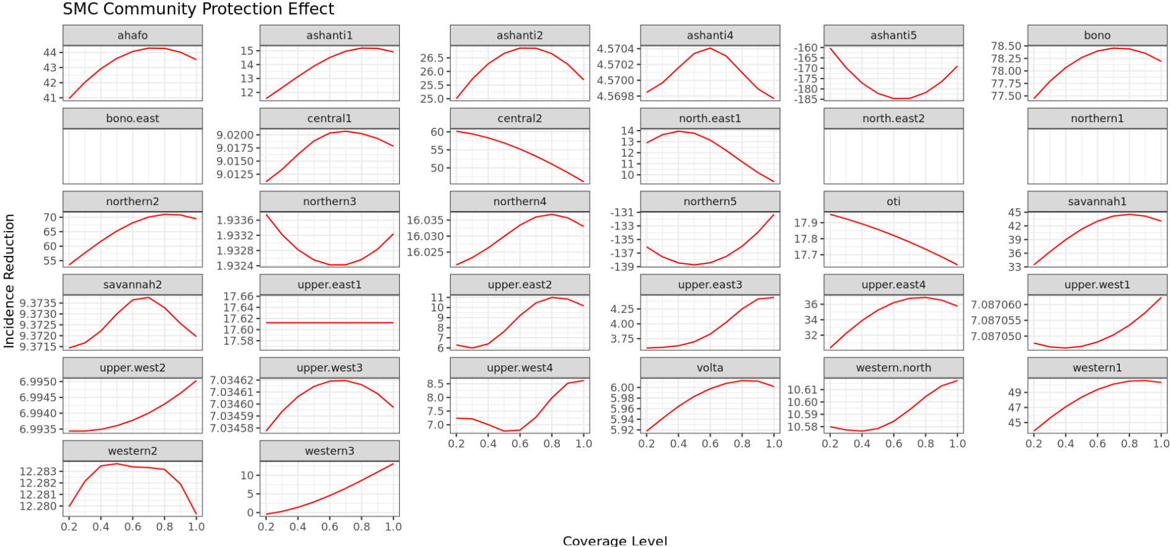
SMC

Slide 7
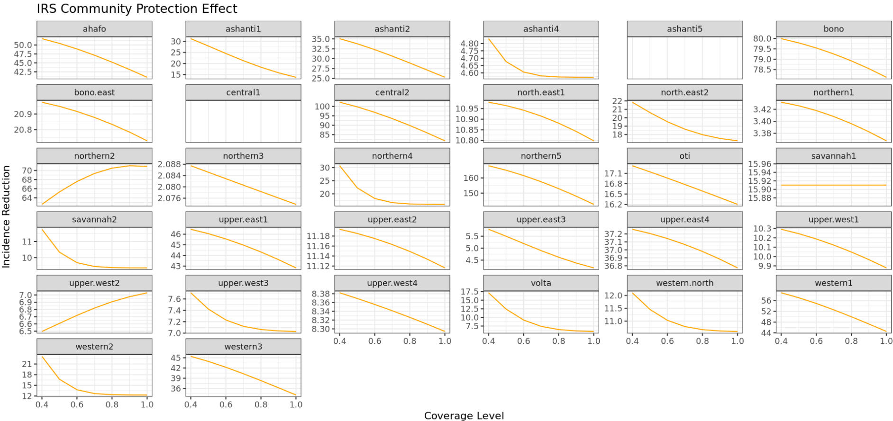
IRS
Notes:
To address uncertainties, we identify and quantify the various sources of uncertainty in intervention modeling

Slide 8
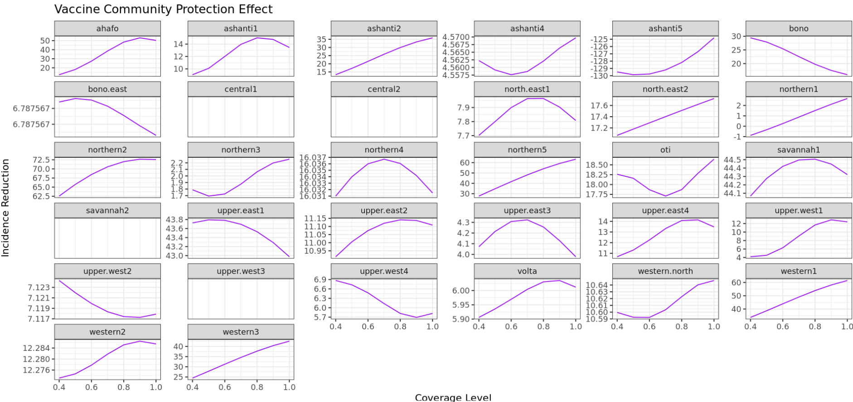
Vaccine

Slide 9
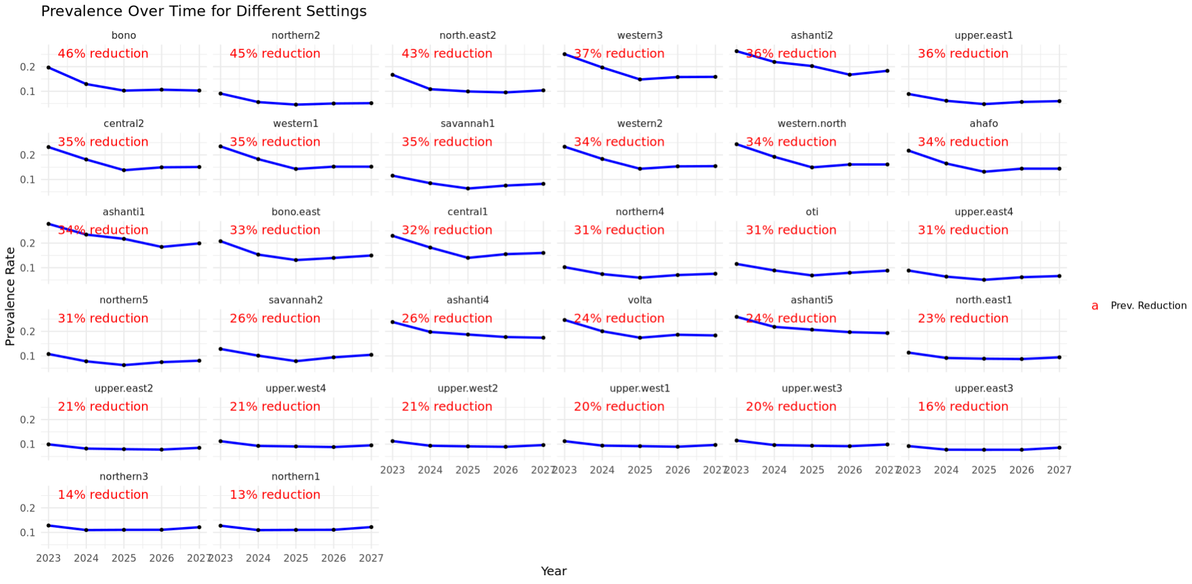
Prevalence over time per setting

Slide 10
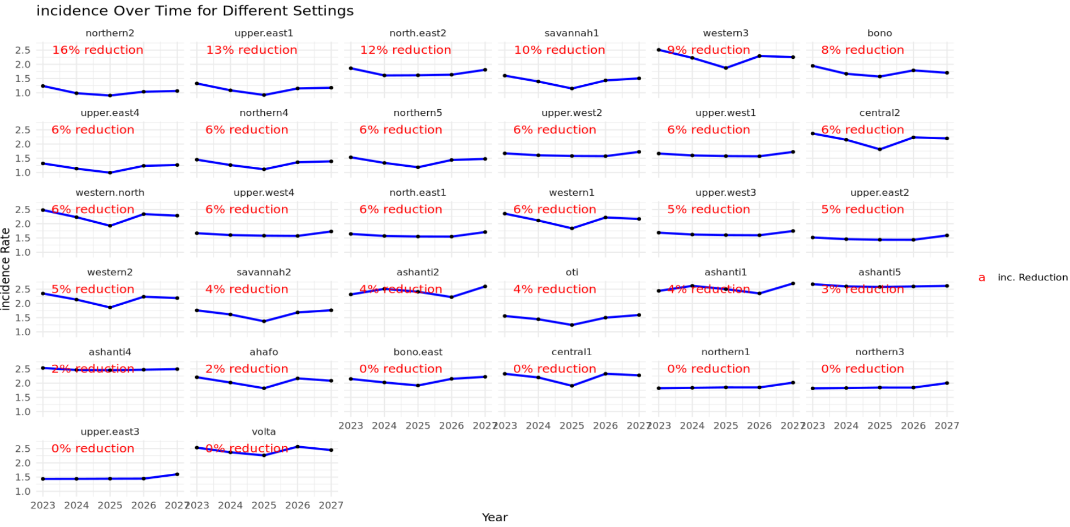
Incidence over time per setting (2023-2026 reduction)

Slide 11
Next steps
TRIAL – retrain GPs with a seq of future coverage levels for all four interventions (predictors) and ntreat1 + ntreat2 or nSevere as outcome

Slide 12
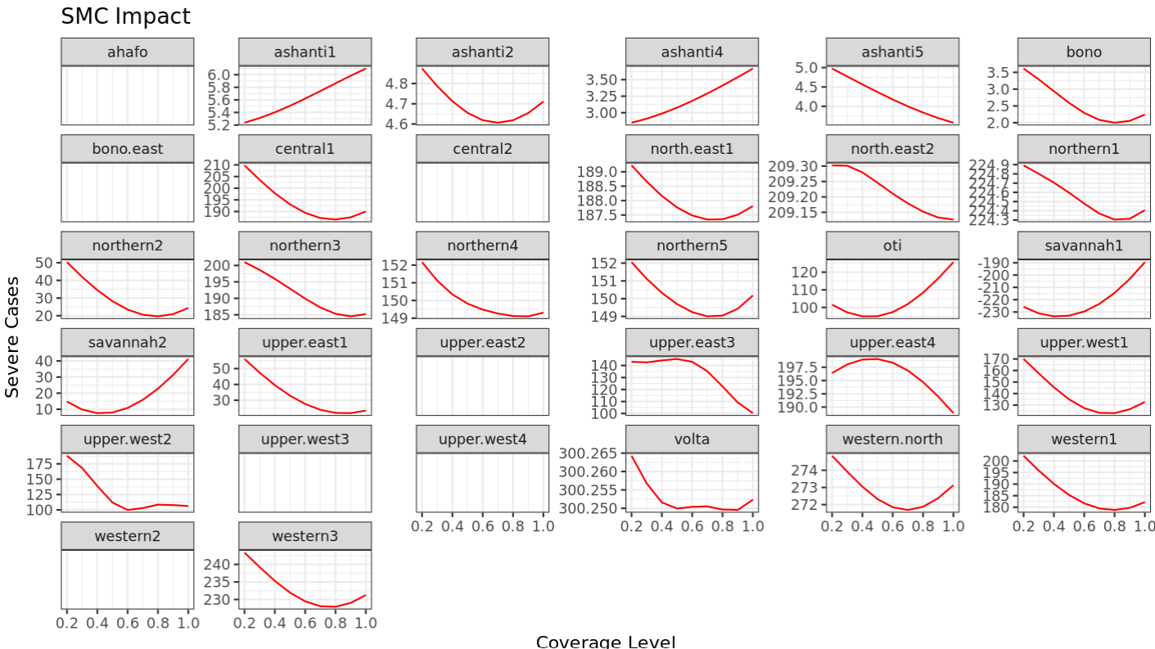
LLIN

Slide 13
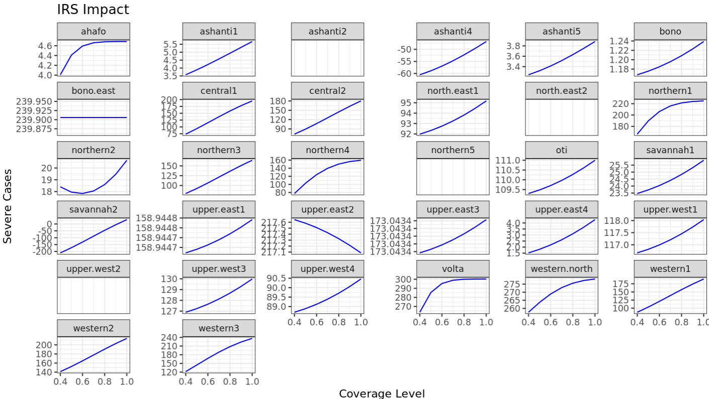
IRS

Slide 14
Next steps
TRIAL – retrain GPs with a seq of future coverage levels for all four interventions (predictors) and ntreat1 + ntreat2 or nSevere as outcome

